Slide 1
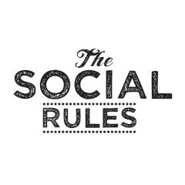
Social Rules, Norms and Values
Dr J Balamurugan

Slide 2
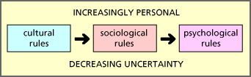

Slide 3
Norms and Values
All societies have ways of encouraging and enforcing what they view as appropriate behavior while discouraging and punishing what they consider to be inappropriate behavior.
They also have a collective idea of what is good and desirable in life - or not.
In this section we will learn to distinguish between the closely related concepts of norms and values.

Slide 4
Norms
An important feature of a group is that, it has a set of rules which controls and modifies of a group of individuals.
The interaction among the members in a group leads to development of rules related to behaviour.
Such rules of a group behaviour are called social norms.
It is highly impossible to imagine a society without norms.
It is a agencies to control the human behaviour.

Slide 5
Conti…
Norms are the established standards of behavior maintained by a society.
For a norm to become significant, it must be widely shared and understood.
Sociologists distinguish between norms in two ways. Norms are classified as either
formal
informal.

Slide 6
Formal Norms
Formal norms generally have been written down and specify strict punishments for violators.
In India, we often formalize norms into laws, which are very precise in defining proper and improper behavior.
Sociologist Donald Black (1995) has termed law “governmental social control,” meaning that laws are formal norms enforced by the state. Laws are just one example of formal norms.

Slide 7
Informal Norms
In contrast, informal norms are generally understood but not precisely recorded.
Standards of proper dress are a common example of informal norms.
Our society has no specific punishment or sanction for a person who comes to school or college, wearing a different suit, different hair cut, etc.

Slide 8
Values
Though we each have a personal set of values—which may include caring or fitness or success in business—we also share a general set of values as members of a society.
Values may be specific, such as honoring one’s parents and owning a home, or they may be more general, such as loyalty, love, and democracy.
Values influence people’s behavior and serve as criteria for evaluating the actions of others.
Values are supposed to be the guidelines of the society. It tells what to do and how to do in different situations.

Slide 9
Difference
Norms are expected and accepted ways of behaving, e.g. wearing shoes.
Values are what people regard as desirable, e.g. having money, the value of education, freedom of speech, etc.

Slide 10
Conclusion
Social norms and values explain the way in which social processes operate in a given society.
They are the social sources of patterned interaction and account for the stability of the social order.
It provide the general guidelines for conduct that what is right and important for the society.
Thus, values such as respect for human dignity, sacrifice, helpfulness, co-operation, individuality, etc., guide our behaviour in various ways.
In doing so, they facilitate social control.

Slide 11
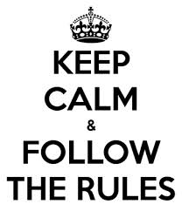
Thank you

